Slide 1
Third School of Economics
Marija Aračić Jana Staroveški
May, 2022.

Slide 2
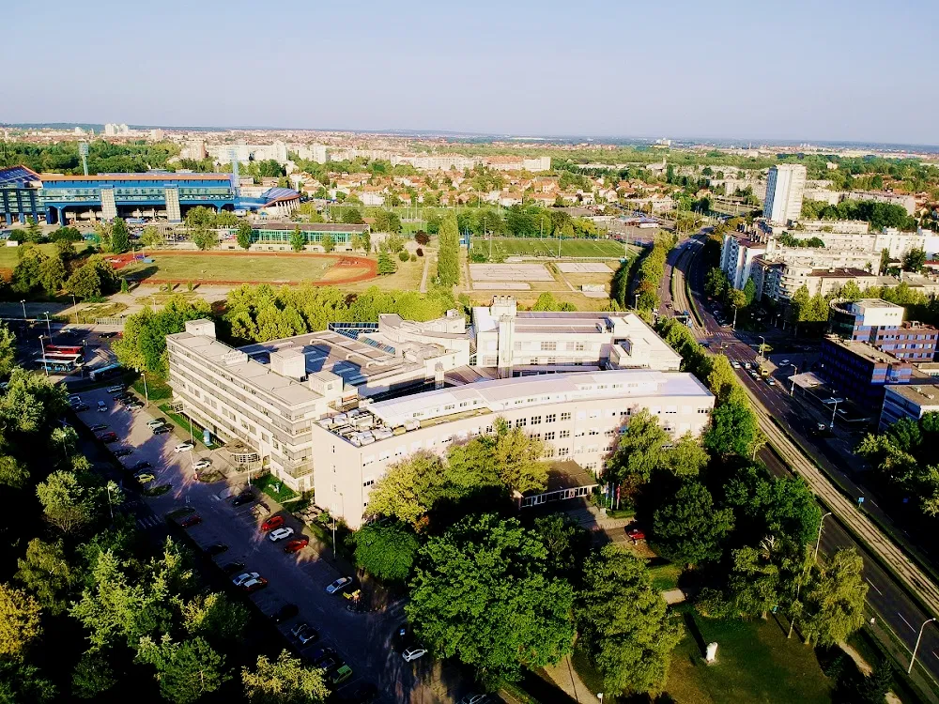
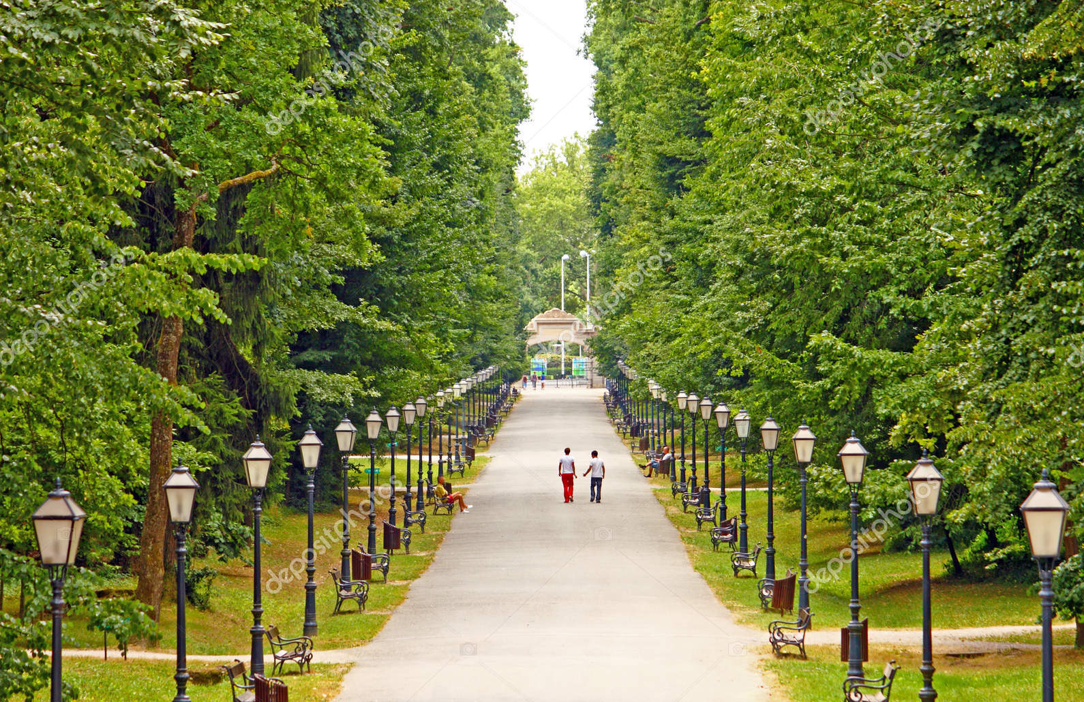
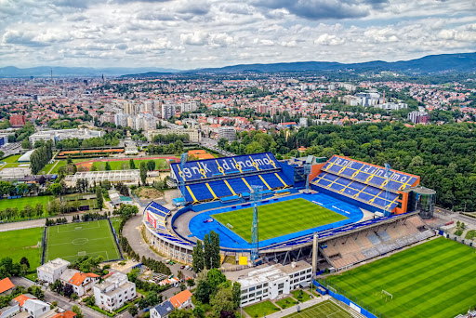
Location & environment
Location
in the neighbourhood of Faculty of Economics, Maksimir park, Dinamo Stadium

Slide 3
History
an independent institution since 1991 (separated from the Trade educational center)
before that time - a part of the School of Economics and Commerce
the first School of that type in former Yugoslavia

Slide 4
Today
473 students
20 classes
64 employees/
51 teachers

Slide 5
Our Programs
Regular classes
Major - Economics, Trade and Business Administration
Additional classes
14 different
Lifelong learning for adults

Slide 6
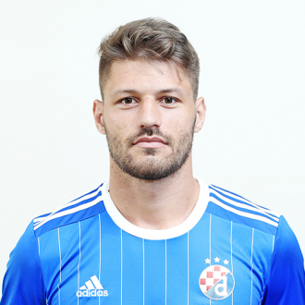
Sport
Many of our students are young football players of the Dinamo football club.
Former students of our school are now football stars.

Slide 7
Projects
We are proud members of Erasmus+ and Etwinning projects.

Slide 8
Our teaching experience in digital age

Slide 9
Platforms we use
Yammer became the official School teaching and communication platform during the lockdown

Slide 10
Thank you! Danke! Hvala!

